Slide 1

Data, Data, More Data
YiLin Liu

Slide 2
Outline
Objective
Context
APIs:
Google Maps
Twitter
Flickr
Facebook
Weather Data

Slide 3
Objective
To Explore various APIs and its usefulness to data scientists through R.

Slide 4

Context

Slide 5





APIs:
1. Google Maps API
2. Twitter API
3. Flickr API
4. Facebook API
5. Weather Data
Notes:
Logo credits: respective companies

Slide 6







Google Maps: Maps API
Directions
Distance Matrix
Elevation
Geocoding
Time Zone
Roads
Places

Slide 7

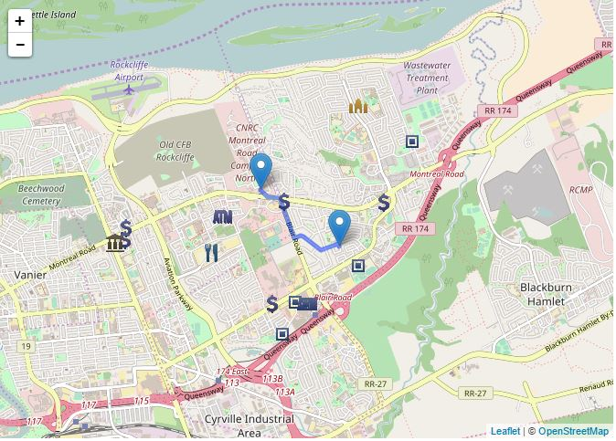
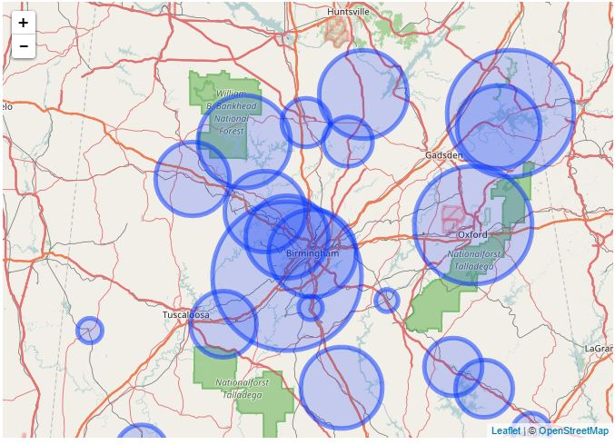
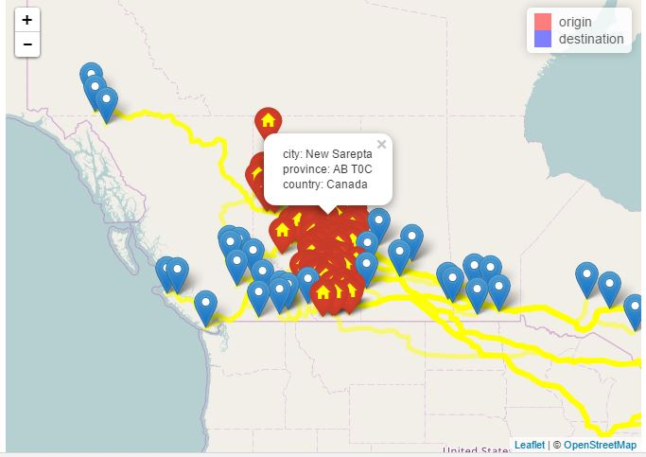
Google Maps:
Directions
Crime Data
Origin/Destination Pairs
Interactive Maps

Slide 8
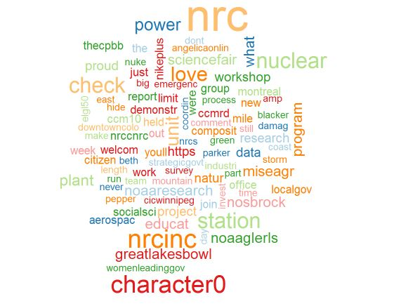
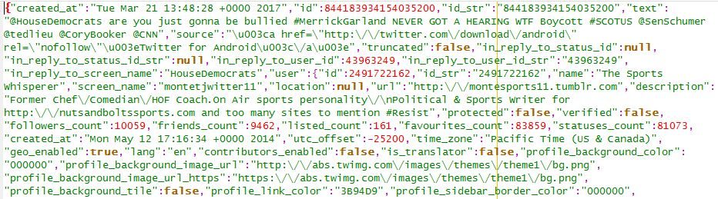
Twitter
Word Map
Stream of CNN Tweets

Slide 9

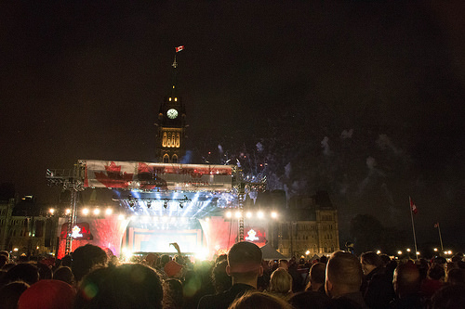
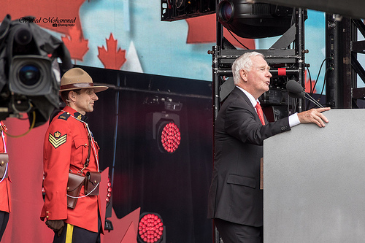
Flickr
Canada Day 2015
Search Response
Photo MetaData
Photo URL

Slide 10
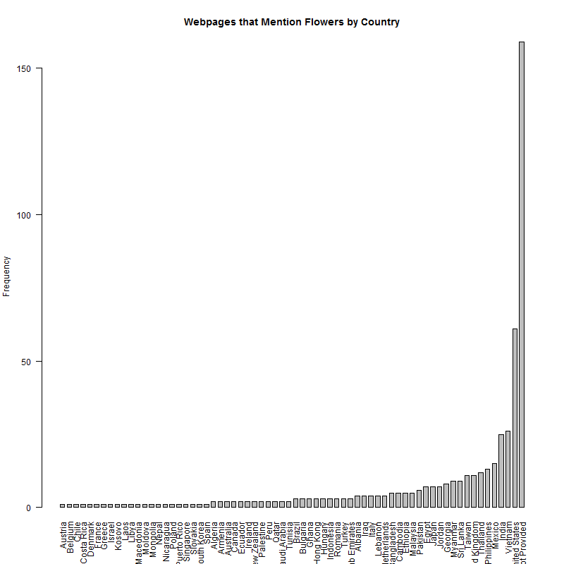
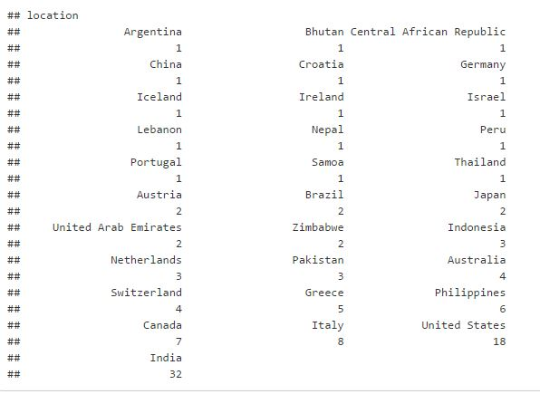
Facebook
Page mentioning Flowers
Most visited locations
webpage

Slide 11

Weather Web Scrapping:
Goal: Compare the accuracy of predicted weather against the actual temperature for Environment Canada Ottawa
Starting Script
Running Script
Sorting Data

Slide 12
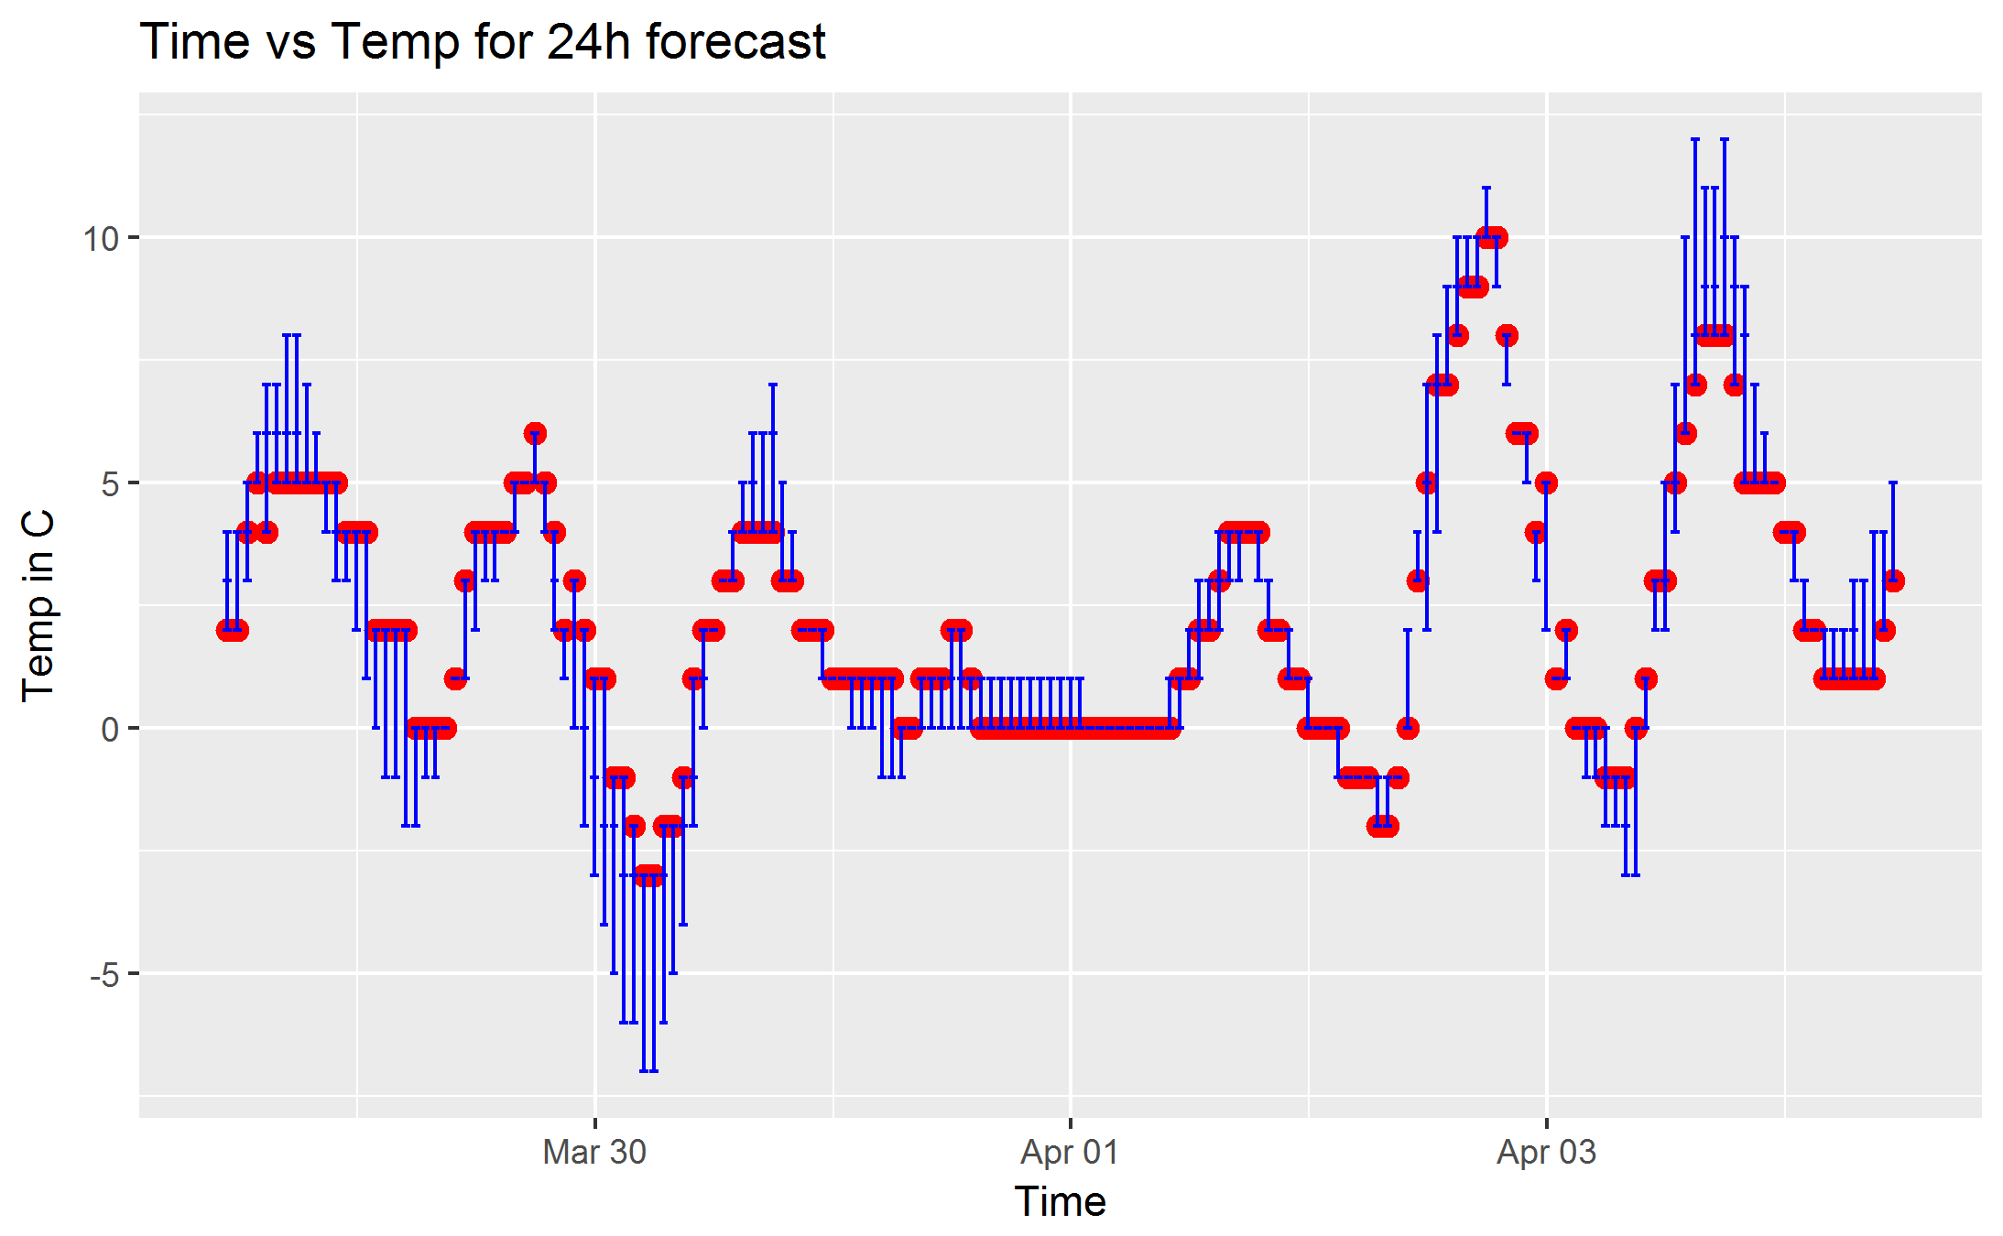
Weather Web Scrapping:
Goal: Compare the accuracy of predicted weather against the actual temperature for Environment Canada Ottawa
Bigger Graph

Slide 13
Questions?

Slide 14
Thank You

Slide 15
Others:
Prophet Package
Exif Tool
Cities Project
Pdf Project

Slide 16

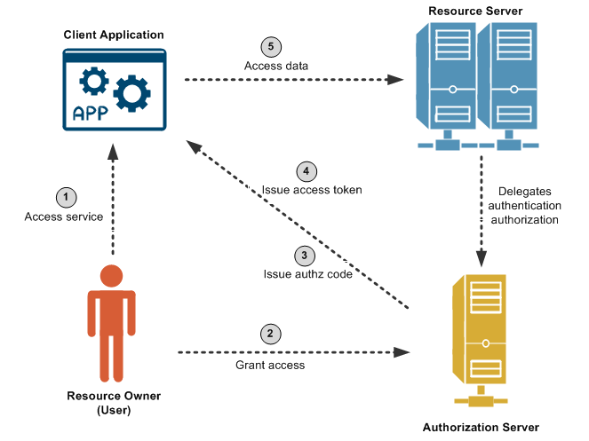
Overview: OAuth
Credit to this page

Slide 17
Answers to Potential Questions
Oauth parameters
Twitter Rate Limit Table
Twitter Search API Queries
Twitter historical search.
Twitter stram API connections
Google Documentations
Flickr Public Search
Library Documentations:
twitteR
streamR

